Slide 1

Bitcoin Return Direction Prediction ——with Deep Learning and Interpretable Features
Group 2: Duan Kaifeng | Xia yi | Zheng Wenxin | Kuang Xuan | Duan Shunxin
2026.04.02

Slide 2


ABSTRACT
Problem Definition and Research Objectives
Overview: We developed a system that predict the next-day direction of Bitcoin (Single Asset) based on Deep Learning method that combines market, on-chain, macro, and sentiment features.
Task formulation: Binary classification task on daily frequency.
`target_t = 1[close_t > close_{t-1}]`
`target_t = 0 otherwise`
Evaluation: Classification metrics + unified financial backtest metrics.
Classification metrics (e.g., AUC/F1)
Financial metrics (e.g., return/Sharpe/drawdown)
Notes:
This project focuses on next-day Bitcoin direction prediction. Our goal is not to over-claim profitability, but to build a reproducible, leakage-safe, and interpretable end-to-end pipeline. We integrate four modules: data, baseline models, GRU, and SHAP, then compare them under a unified backtesting protocol.
The task is daily binary classification with label target_t = 1[close_t > close_{t-1}]. We use a two-layer evaluation: classification metrics first, unified financial backtest metrics second. This avoids relying on accuracy/AUC alone without checking trading consequences.

Slide 3
CONTENT
DATA ENGINEERING
1
Data Sources and Features
Final Feature Groups
Leakage Control
2
BASELINE & GRU
Baseline Experimental Results
GRU Modeling and Experimental Results
SHAP & Financial Backtest
3
SHAP Global Interpretation SHAP Local Interpretation and Feature Ranking
Unified Backtesting Results
4
SUMMARY
What We Learned
Conclusion, Limitation and Next Steps
Notes:
The presentation has four parts: Data Engineering, Baseline & GRU, SHAP & Financial Backtest, and Summary. The logic is: ensure data rigor first, compare models second, interpret decisions third, and deliver a disciplined conclusion last.

Slide 4
PART 1
DATA ENGINEERING

Slide 5
1. DATA ENGINEERING
1.1 Data Sources and Features
Source | Type | Example Variables | Role in Modeling
Binance Spot API | Market microstructure / price-volume | open, high, low, close, volume, quote_volume, trade_count | Core market state and return dynamics
Blockchain.com Charts API | On-chain network activity | active_addresses, tx_count, hash_rate, fees, difficulty | Captures blockchain usage, congestion, and mining condition
FRED | Macro-financial environment | vix, sp500_return, dxy_proxy | Adds global risk sentiment and cross-market context
Alternative.me | Crypto sentiment index | fear_greed_index | Proxies market emotion and short-term behavioral pressure
Final dataset: 2966 rows, 27 columns
Date range: 2018-02-02 to 2026-03-17
Missing rate in final table: 0.00%
Notes:
We combine four source types: exchange market data, on-chain indicators, macro factors, and sentiment index. The final dataset has 2,966 rows, 27 columns, and 0% missingness. This gives a consistent and traceable input foundation for all experiments.

Slide 6
1. DATA ENGINEERING
1.2 Final Feature Groups
Feature Group | Variables | Why It Matters
Price & Trading | open, high, low, close, volume, quote_volume, trade_count | Captures immediate market movement and liquidity condition
On-chain Activity | active_addresses, tx_count, hash_rate, fees, difficulty | Reflects network utilization, transaction pressure, and mining regime
Macro Factors | vix, sp500_return, dxy_proxy | Encodes broader market risk and dollar/liquidity conditions
Sentiment | fear_greed_index | Adds behavioral signal from crypto crowd sentiment
Engineered Features | *Short-horizon transformed signals from price, volume, and on-chain dynamics | Transforms raw signals into model-friendly short-horizon predictors
Target | target = 1[close_t > close_{t-1}] | Binary direction label for daily prediction
*Engineered Features Specs:
ret_1d, ret_3d, volatility_7d, ma_ratio_7_30, high_low_spread, volume_change, active_addresses_change, fees_per_tx, difficulty_change
Notes:
Features are grouped into price/trading, on-chain activity, macro factors, sentiment, and engineered features. Engineered features capture short-horizon dynamics such as returns, volatility, ratios, and change signals. The target definition is fixed across all models for consistency.

Slide 7
1. DATA ENGINEERING
1.3 Leakage Control
# Implementation (from original pipeline)
```python
feature_columns = [...]
merged[feature_columns] = merged[feature_columns].shift(1)
final_df = merged.dropna(subset=[*feature_columns, "target"]).reset_index(drop=True)
```
# Latest day exclusion: `remove_latest_binance_day(...)`
# Target rule: `target = (close > close.shift(1))`
R1: Shift all modeling predictors by one period
R2: Exclude the latest incomplete trading day
R3: Keep a fixed target definition and test it
Notes:
We enforce three leakage-control rules: one-period feature lagging, exclusion of the latest incomplete trading day, and fixed target definition with regression checks. The key principle is that information at time t must be available at time t. This section is central to methodological credibility.

Slide 8
PART 2
BASELINE & GRU

Slide 9
2. BASELINE & GRU
2.1 Baseline Experimental Results
Baselines: Logistic Regression (L1) and Random Forest
Model | accuracy | precision | recall | f1 | auc
Baseline-LR(L1) | 0.499 | 0.495 | 0.659 | 0.565 | 0.493
Baseline-RF | 0.499 | 0.485 | 0.227 | 0.31 | 0.456
Classification quality remains near-random in this run
These models define the empirical reference level
Notes:
Baseline models are Logistic Regression (L1) and Random Forest. Their classification performance is near random, indicating a noisy and challenging task. These models serve as empirical reference levels for later comparison.

Slide 10
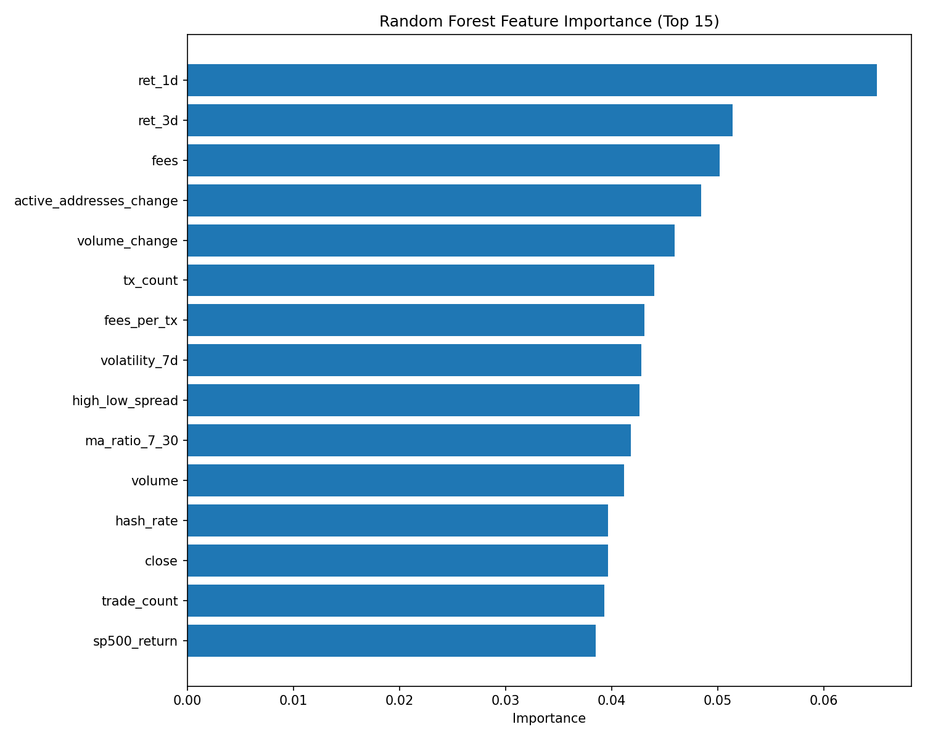
2. BASELINE & GRU
2.1 Baseline Experimental Results
Baselines: Logistic Regression (L1) and Random Forest
Random Forest importance plot shows:
Short-horizon return and activity-related variables contribute most to baseline predictions;
While many other features have relatively limited marginal contribution.
Explanation: This indicates that the baseline model is driven by a concentrated subset of signals rather than broad, uniform feature usage.
Model | accuracy | precision | recall | f1 | auc
Baseline-LR(L1) | 0.498876 | 0.494881 | 0.659091 | 0.565302 | 0.493394
Baseline-RF | 0.498876 | 0.485437 | 0.227273 | 0.309598 | 0.456323
Classification quality remains near-random in this run
These models define the empirical reference level
Notes:
Random Forest importance suggests short-horizon returns and activity-related variables are the strongest contributors. So the model is not purely random; it is driven by a concentrated subset of signals. This also provides a useful prior check against later SHAP findings.

Slide 11
2. BASELINE & GRU
2.2 GRU Modeling and Experimental Results
GRU setup: temporal split (70/15/15), class-weighted BCE
Key Hyperparameters: seq_len=10, hidden_size=32, lr=5e-4
Model | accuracy | precision | recall | f1 | auc
Baseline-LR(L1) | 0.499 | 0.495 | 0.659 | 0.565 | 0.493
Baseline-RF | 0.499 | 0.485 | 0.227 | 0.31 | 0.456
GRU | 0.511 | 0.556 | 0.046 | 0.084 | 0.534
Classification Signal: GRU has the highest AUC (0.534), indicating better ranking ability.
Precision–Recall Trade-off: GRU predicts “up” more conservatively: precision is higher, recall is lower.
Practical Reading: Classification improvement is modest; financial impact is validated in unified backtesting.
Notes:
GRU uses temporal split (70/15/15), class-weighted BCE, with seq_len=10, hidden_size=32, and lr=5e-4. GRU achieves higher AUC than baselines, while F1 remains low, indicating conservative “up” predictions. The takeaway is modest classification improvement that still requires financial validation.

Slide 12
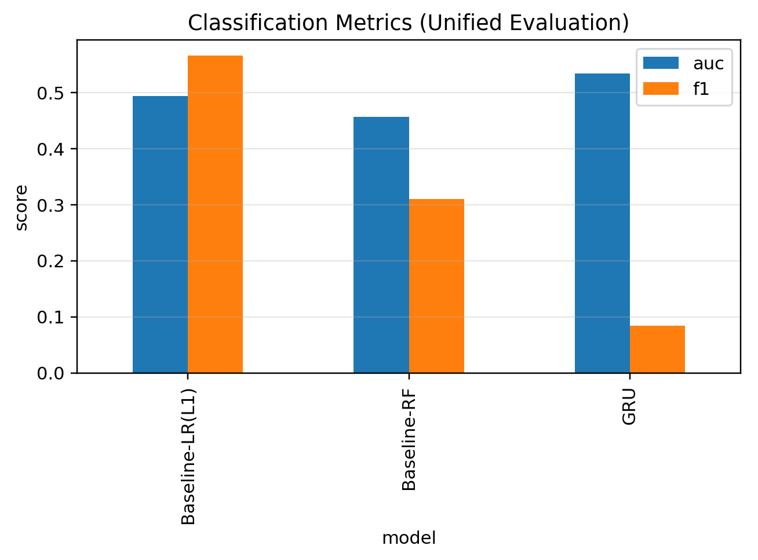
2. BASELINE & GRU
2.2 GRU Modeling and Experimental Results
GRU setup: temporal split (70/15/15), class-weighted BCE
Key Hyperparameters: seq_len=10, hidden_size=32, lr=5e-4
Model | accuracy | precision | recall | f1 | auc
Baseline-LR(L1) | 0.499 | 0.495 | 0.659 | 0.565 | 0.493
Baseline-RF | 0.499 | 0.485 | 0.227 | 0.31 | 0.456
GRU | 0.511 | 0.556 | 0.046 | 0.084 | 0.534
Classification Signal: GRU has the highest AUC (0.534), indicating better ranking ability.
Precision–Recall Trade-off: GRU predicts “up” more conservatively: precision is higher, recall is lower.
Practical Reading: Classification improvement is modest; financial impact is validated in unified backtesting.
Notes:
This slide highlights metric structure: GRU improves ranking ability, but threshold-based classification gains are limited. In other words, statistical signal exists, but it does not automatically imply strong tradable alpha. That is why unified backtesting is necessary.

Slide 13
PART 3
SHAP & Financial Backtest

Slide 14
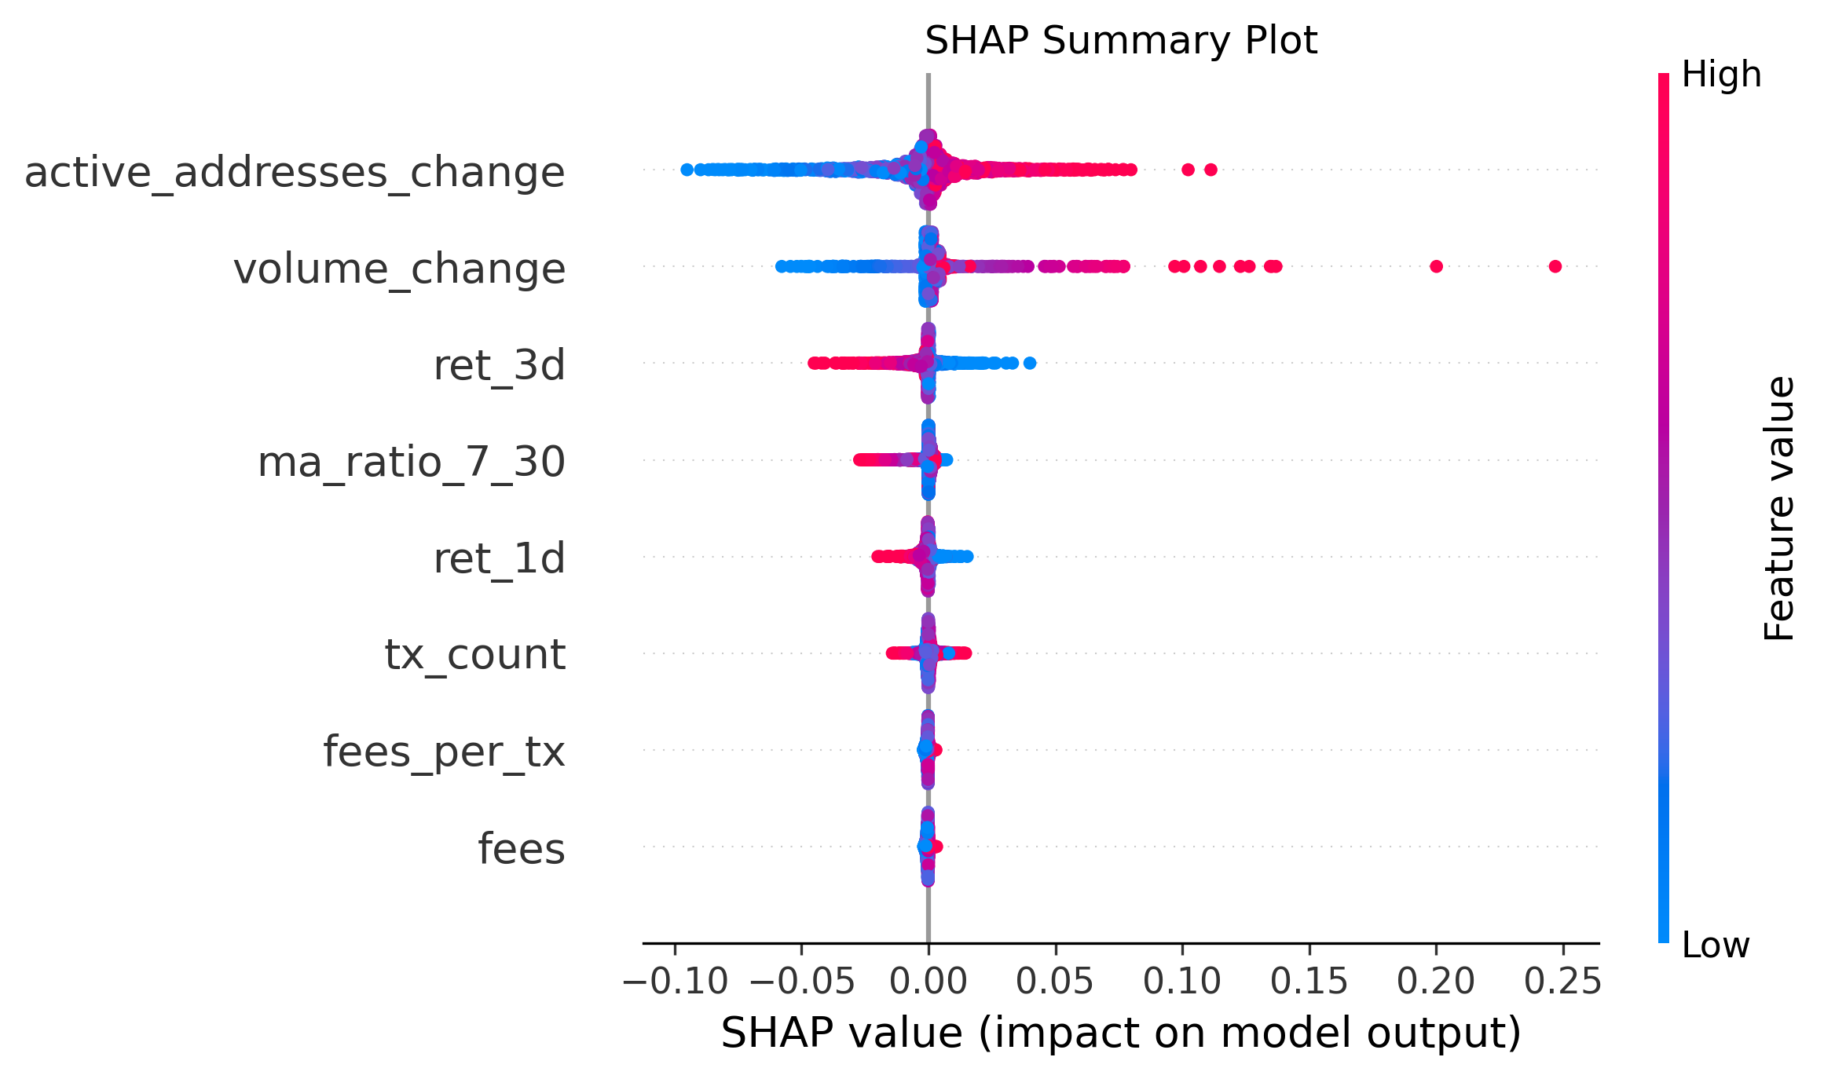
3. SHAP & Financial Backtest
3.1 SHAP Global Interpretation
Global SHAP ranking highlights active_addresses_change as the dominant signal
Volume and short-horizon return factors are also influential
Notes:
Global SHAP identifies active_addresses_change as the dominant feature, with volume_change and short-horizon return factors also influential. This suggests the model uses meaningful market and on-chain structure rather than pure noise. It answers the question: what the model mainly relies on.

Slide 15
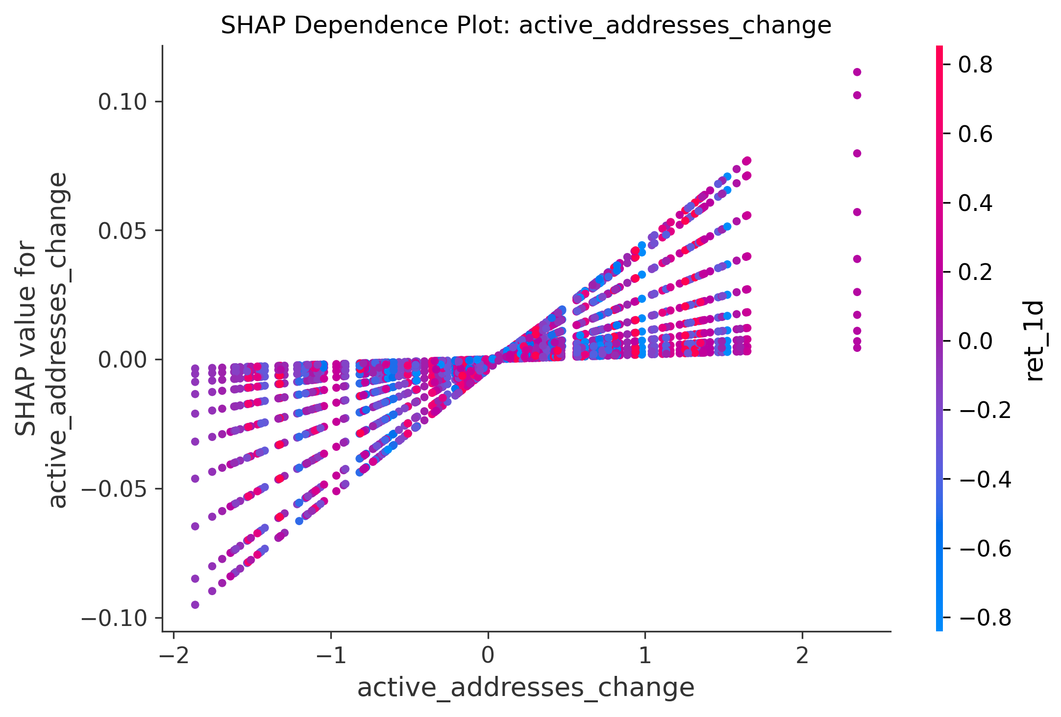
3. SHAP & Financial Backtest
3.2 SHAP Local Interpretation and Feature Ranking
feature | mean_abs_shap
active_addresses_change | 0.0134
volume_change | 0.00465
ret_3d | 0.00364
ma_ratio_7_30 | 0.00185
ret_1d | 0.00171
tx_count | 0.00151
fees_per_tx | 0.000479
fees | 0.000457
Dependence analysis shows directional contribution patterns for key on-chain activity
Local behavior is consistent with the global importance ranking
Notes:
The dependence plot shows directional local effects for key features and is consistent with global ranking. This strengthens interpretability because we observe not only importance, but also contribution direction. The interpretation is broadly aligned with economic intuition.

Slide 16
3. SHAP & Financial Backtest
3.3 Unified Backtesting Results
Motivation:
Classification metrics alone do not measure trading consequences.
Backtesting translates predictions into realized return, risk, and drawdown under execution rules.
A unified protocol allows fair model comparison beyond accuracy-style metrics.
# One protocol for all models: same signal rule, same transaction cost, same metric family.
```python
TRADING_FEE = 0.001
bt["ret_next"] = bt["close"].pct_change().shift(-1)
bt["position"] = bt["pred_up"]
bt["trade"] = bt["position"].diff().abs().fillna(bt["position"].abs())
bt["strategy_return"] = bt["position"] * bt["ret_next"] - bt["trade"] * TRADING_FEE
metrics = {"total_return", "sharpe_ratio", "max_drawdown", "avg_daily_return", "std_daily_return", "n_days"}
```
Notes:
Unified backtesting translates predictions into realized return/risk under executable rules. We keep one protocol for all models: same signal rule, transaction cost, and metric family. This ensures fair comparison at the strategy level, not only at the classifier-score level.

Slide 17
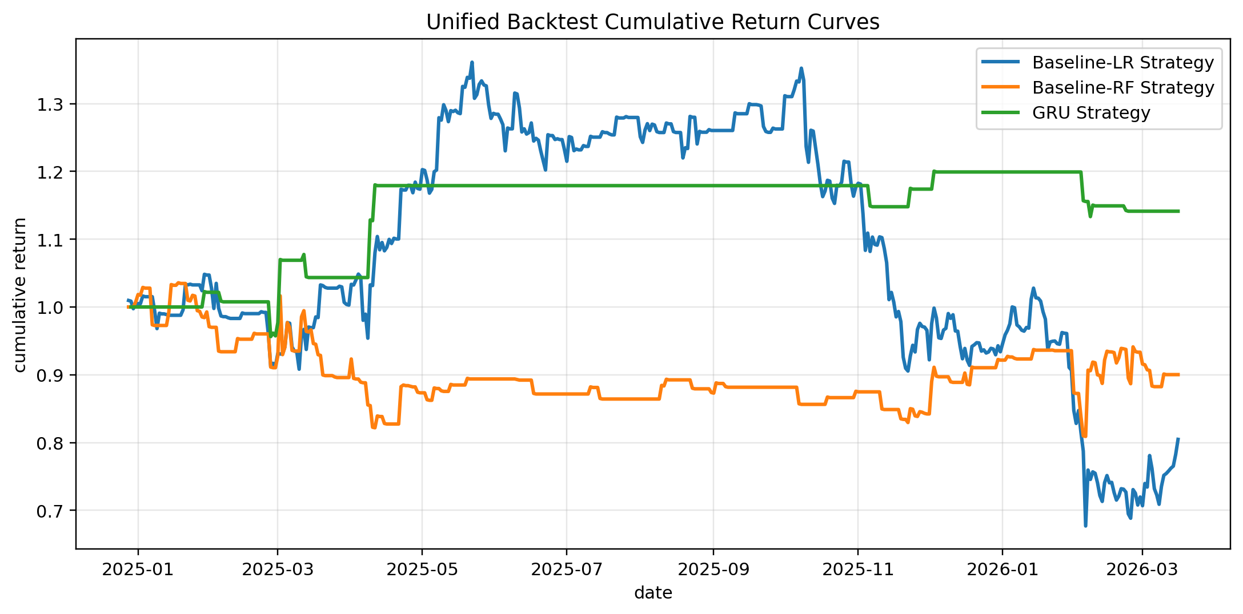
3. SHAP & Financial Backtest
3.3 Unified Backtesting Results
More stable cumulative path
Late-period drawdown pressure
GRU remains above 1.0 for most of the test window.
Both baseline strategies finish below 1.0.
Performance divergence becomes clear after mid-window.
Notes:
The cumulative curves diverge clearly in the mid-to-late test window. GRU stays above 1.0 for most of the period and follows a more stable path; both baselines finish below 1.0. This is the visual evidence of relative strategy-level advantage under unified rules.

Slide 18
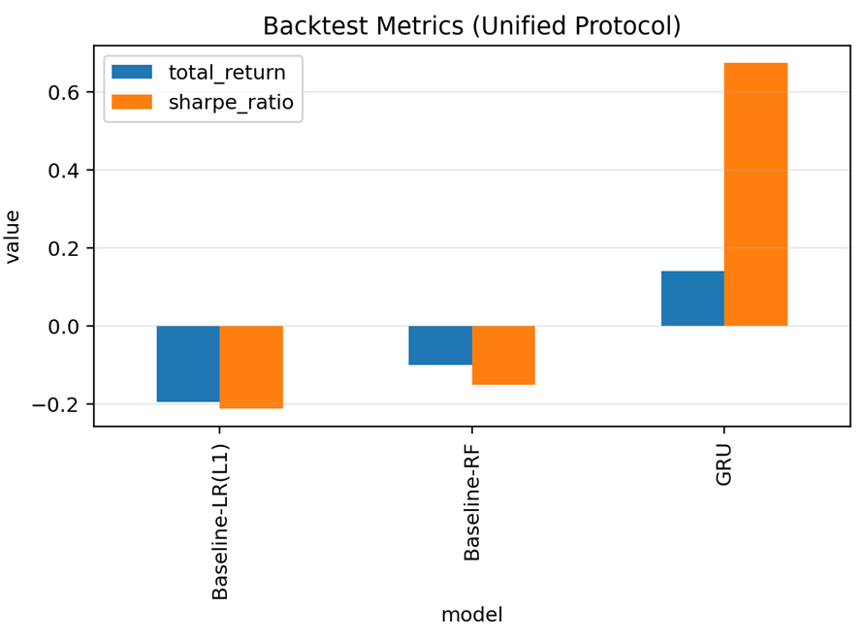
3. SHAP & Financial Backtest
3.3 Unified Backtesting Results
Metric-level confirmation of the curve pattern (return, Sharpe, drawdown).
model | LR(L1) | RF | GRU
total_return | -0.195 | -0.0998 | 0.141
sharpe_ratio | -0.213 | -0.151 | 0.674
max_drawdown | -0.503 | -0.219 | -0.065
avg_daily_return | -0.00028 | -0.00014 | 0.00033
std_daily_return | 0.0206 | 0.0143 | 0.0077
n_days | 444 | 444 | 443
Notes:
Metric-level results confirm the curve pattern: GRU is relatively better in total return, Sharpe, and drawdown. We keep the conclusion disciplined: this is a relative improvement, not a strong alpha claim. The contribution is best framed as rigorous workflow + weak-signal evidence + consistent interpretability.

Slide 19
PART 4
SUMMARY

Slide 20
4. SUMMARY
4.1 What We Learned
Predictive signal exists but is not strong enough for aggressive alpha claims
Interpretability adds evidence on which signals drive model decisions
Methodological rigor (leakage control + unified evaluation) is the main contribution
4.2 Conclusion, Limitation and Next Steps
Conclusion: Reproducible pipeline completed; GRU shows better risk-return under unified backtesting in this run;
Limitation: Short-horizon BTC direction remains noisy and event-driven
Next Steps: Align windows perfectly, export per-day predictions, extend to regime-aware risk targets
Notes:
What we learned: there is predictive signal, but not strong enough for aggressive alpha claims; interpretability helps identify drivers; methodological rigor is a major contribution. Limitations come from high noise and event-driven behavior in short-horizon BTC direction. Next steps include regime-aware modeling, risk-targeted objectives, and stronger threshold/position design.

Slide 21
THANK YOU
【Designed by Group2】

